Slide 1
Solar Capstone Project
Johnson LiANG
Raphael Najera
Adrian Caprini

Slide 2
Introduction (Proposal)
Uses solar panel PV's from the roof of the L building on Humber College North Campus
Uses a database to store the information from each of the solar panel PV's onto the mobile and web application.

Slide 3
BACKGROUND
Fossil fuel is a heavily relied on energy source however, this is harmful to the environment because of its greenhouse gas emissions
A good alternative is solar energy; it is renewable and clean energy collected from the sun

Slide 4
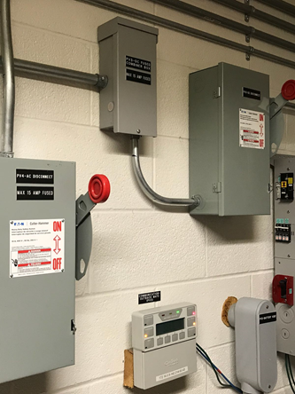
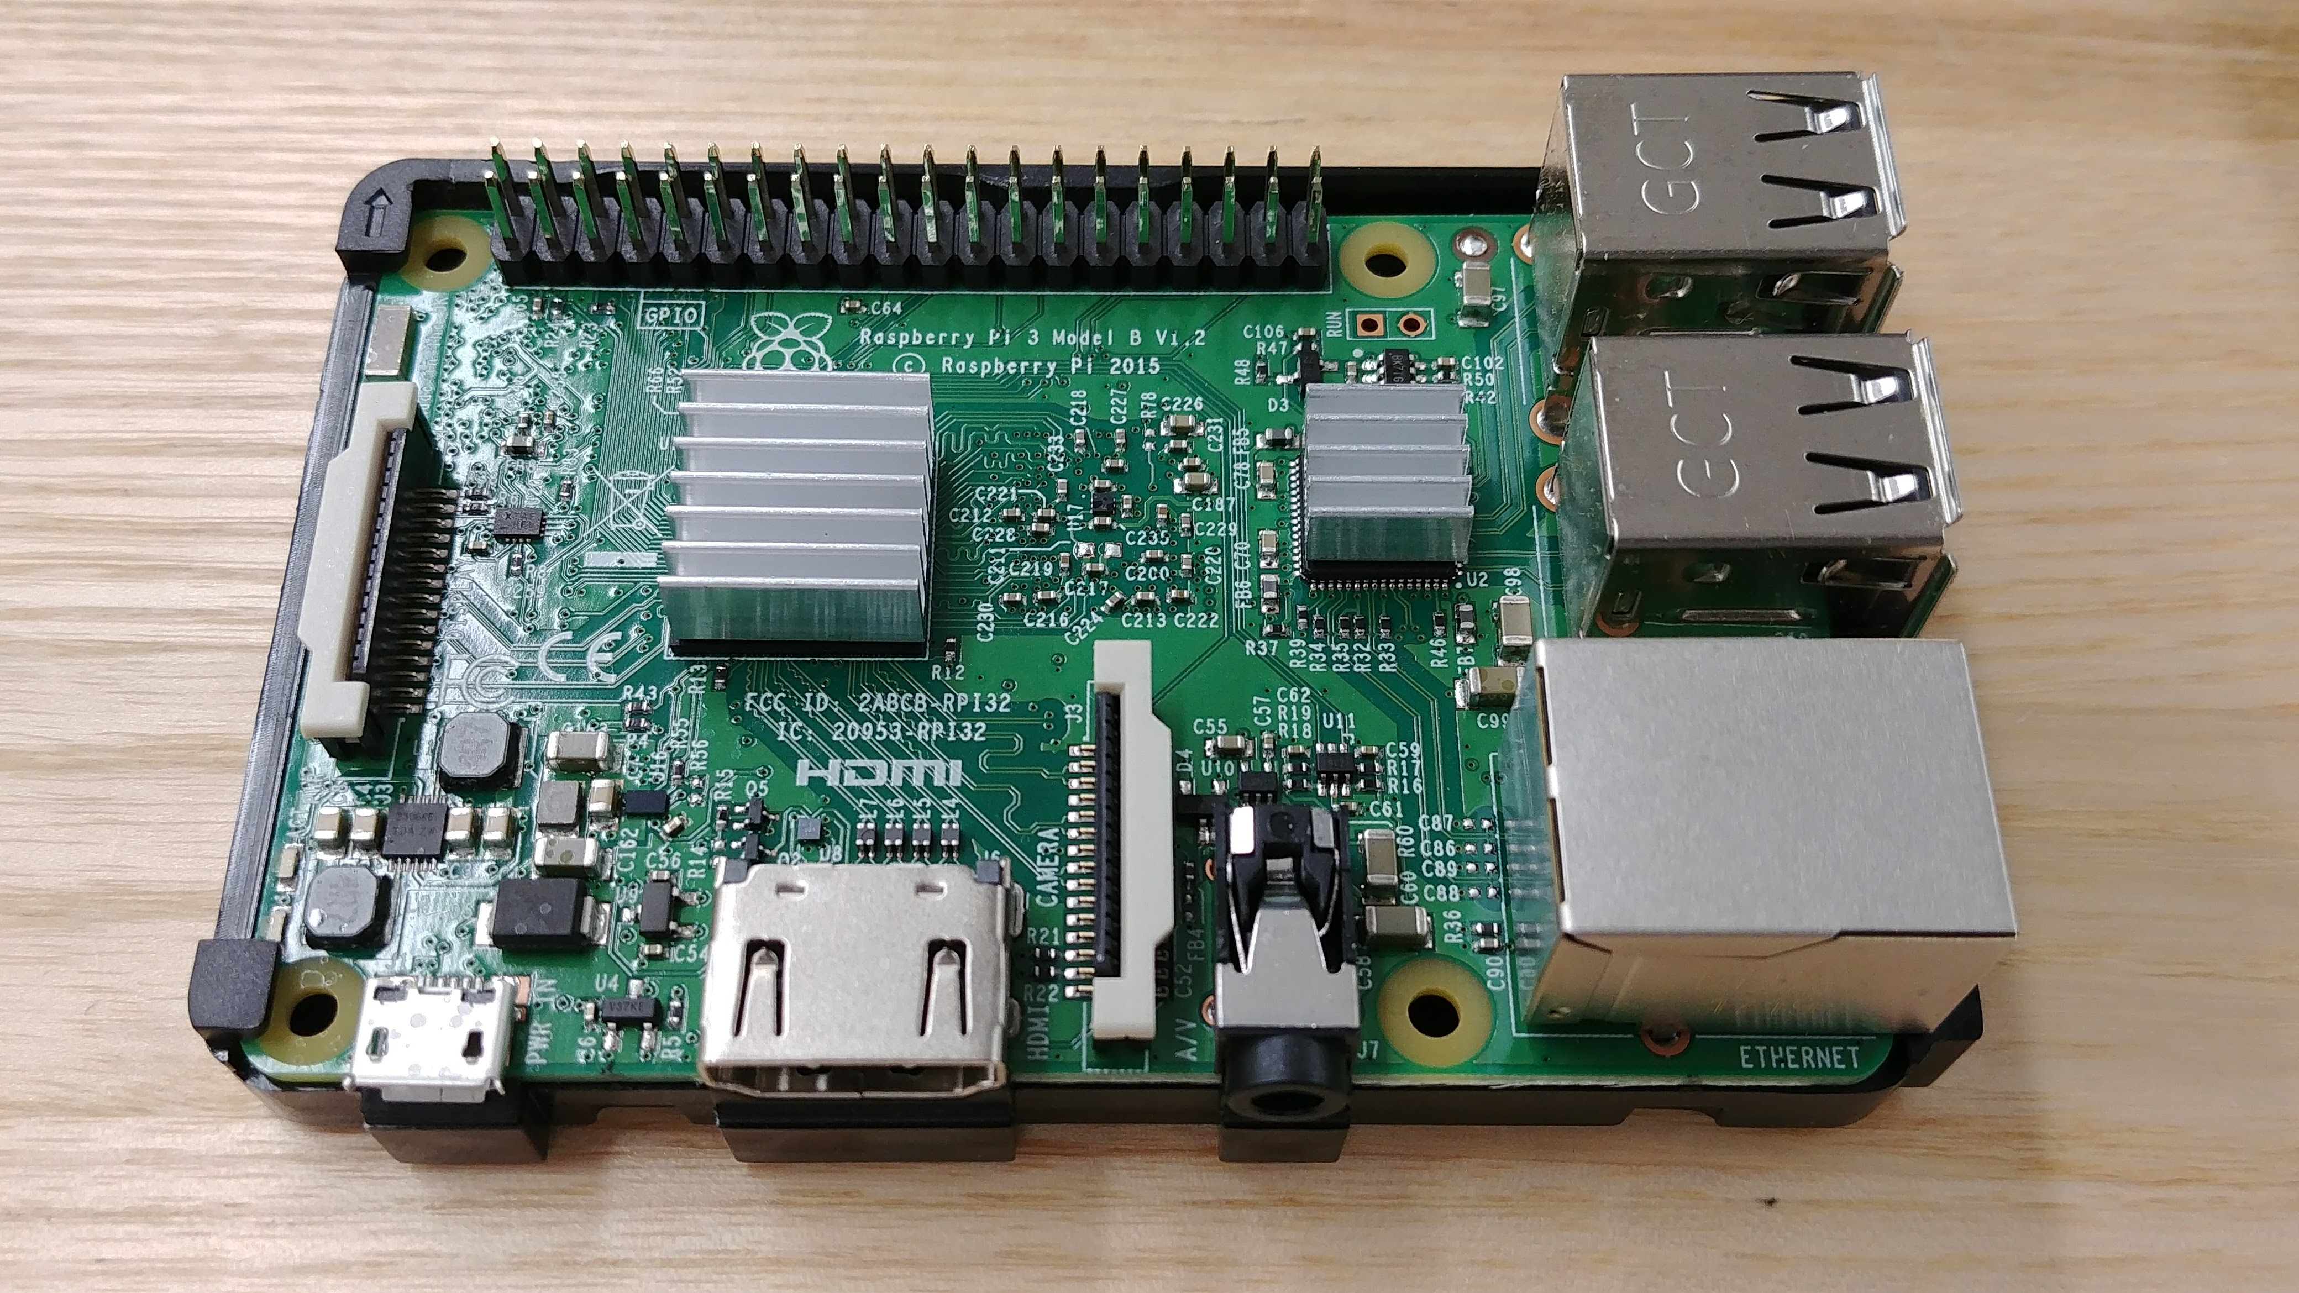
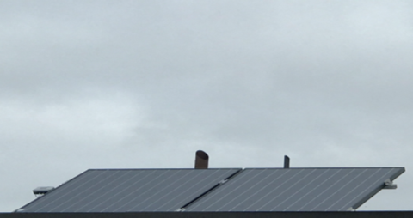
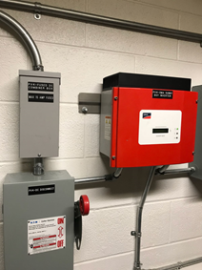
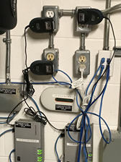
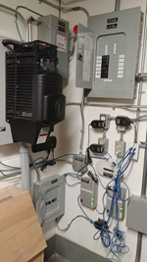
Budget
Raspberry Pi 3, ($112.99)
Solar Panels PVs (Provided)
Located at Humber L240 building
PV1 & PV4: Sunny Webbox
PV2: Envoy Communications Gateway
PV3: Outback Power
Total $112.99

Slide 5
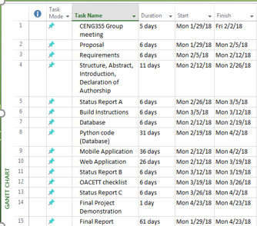
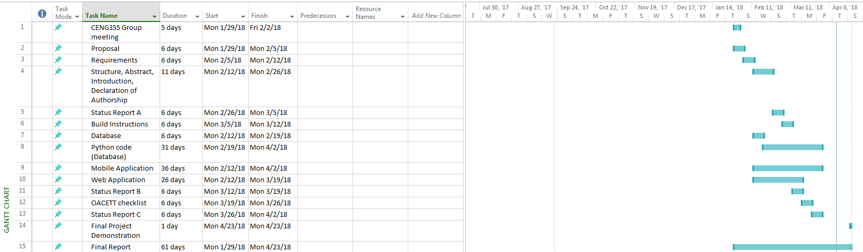
Project Schedule
Proposal
Requirements
T.R (Structure, Abstract, Introduction, authorship)
Status Report A:
Python code for PV1, PV2, PV4 to save the data to firebase
Build instruction
Status Report B:
Mobile Application
Web Application
Checklist, Conclusion
Status Report C:
Added PV3 to python code and code for deleting the log up to 30 days
Technical Report

Slide 6
Course knowledge utilized from previous courses
CENG 216 Introduction to Software Engineering – Learning about Gantt chart/project schedule
CENG 200 Unix Scripting – learning unix cmds. For example, ls, nano
Writ 220 Technical Workplace Writing – Writing status report, documents, proposal, technical report, build instruction
CENG 254 Database with Java – Setting up the database, pushing and retrieving data from the database
CENG 256 Internet Programming – Creating web application
CENG 319 Software Project – Creating mobile application
CENG 320 Hardware Production Technology – GitHub, blog,

Slide 7
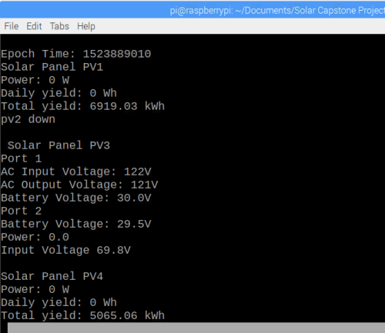
Python script
Python library used:
Beautifulsoup 4 – pull data from the PV’s html
Pyrebase – Firebase API, allows to push and pull data from the firebase
APscheduler – allow to schedule functions
Push the entries to the firebase every 30 minutes
Using Epoch time to compare and delete the old entries up to 30 days.

Slide 8
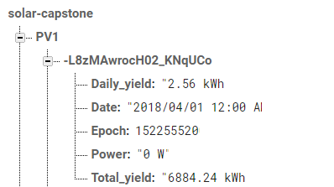
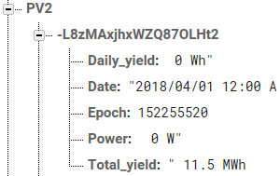
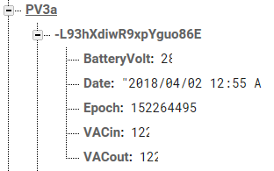
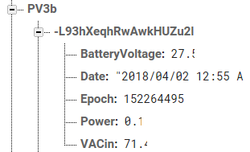
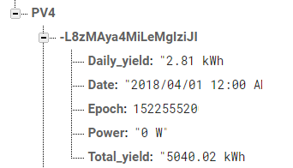
Firebase Database
Uses Firebase to store the values from each of the solar panel PVs
Separate tables for each of the solar panel PVs
entries last up to 30 days

Slide 9
Mobile device Application
Display the data retrieved from the firebase
PV1, PV2, PV4 Displays Current data and time, Power, Daily yield
PV3 Displays:
Inverters: BatteryVolt, VACin, VACout
Charge Controllers: BatteryVolt, Power, VAC
History of each of the solar panel PVs
Button to our Web Application

Slide 10
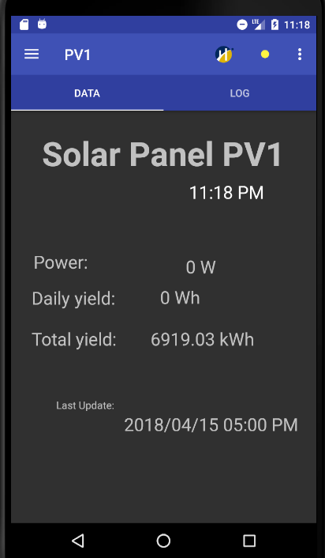
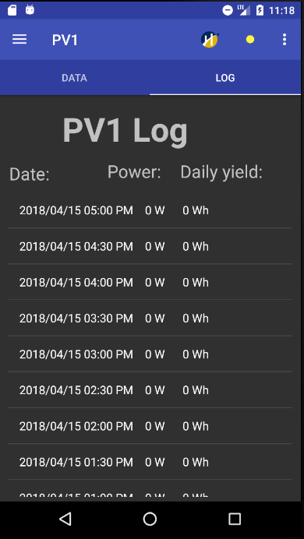
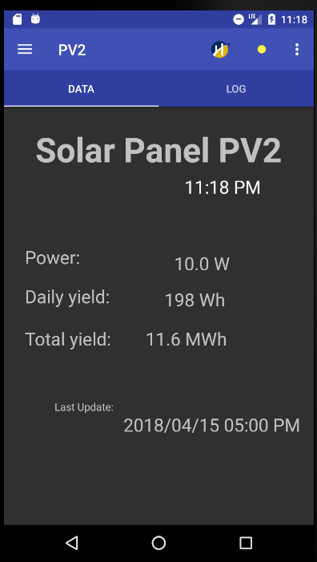
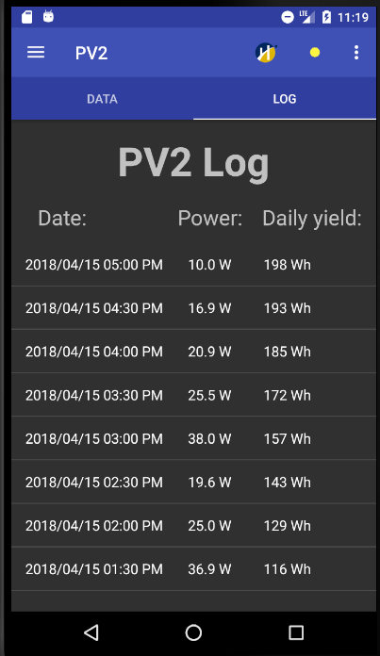
PV1
PV2

Slide 11
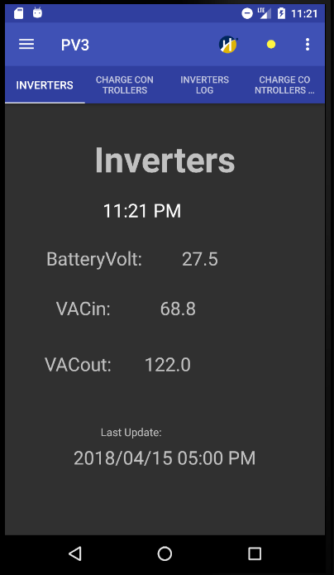
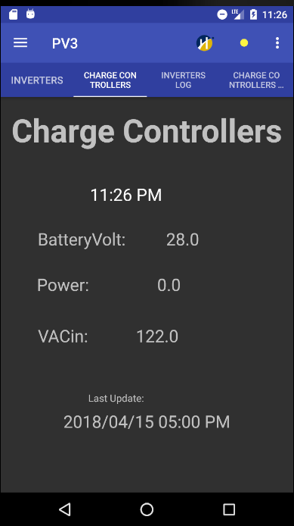
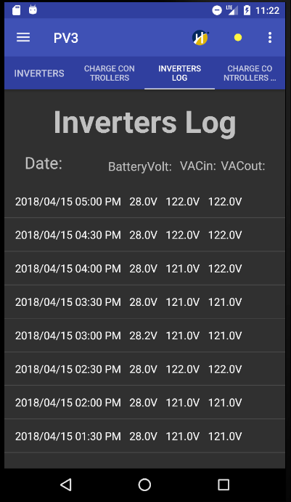
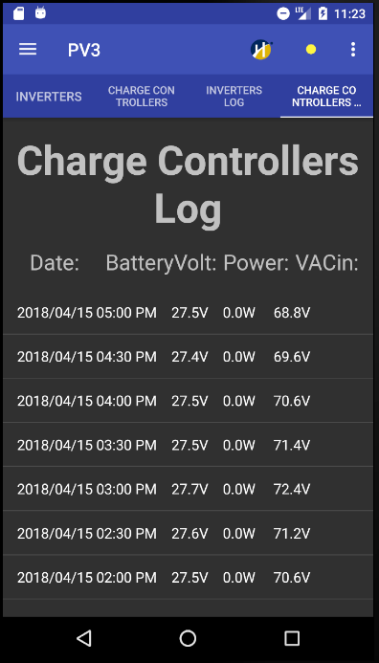
PV3

Slide 12
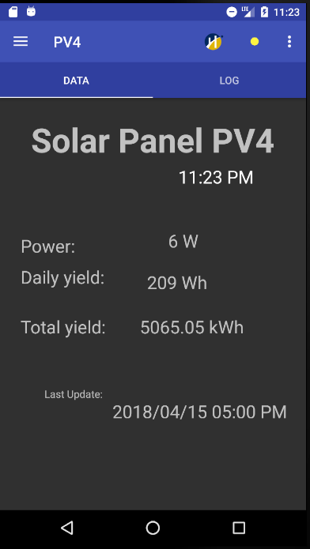
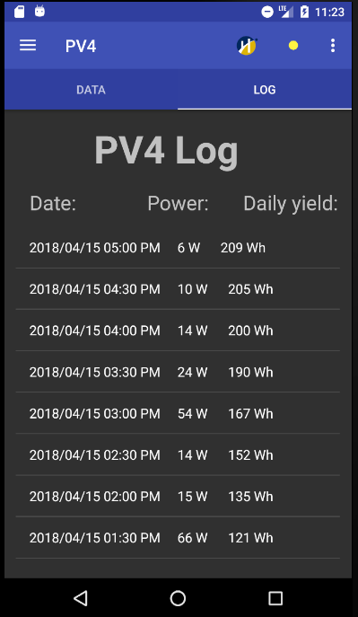
PV4

Slide 13
Web application
One HTML is divided into four different frames.
These frames access the Firebase and displays power and daily/total yield of energy
This is accomplished using JavaScript

Slide 14
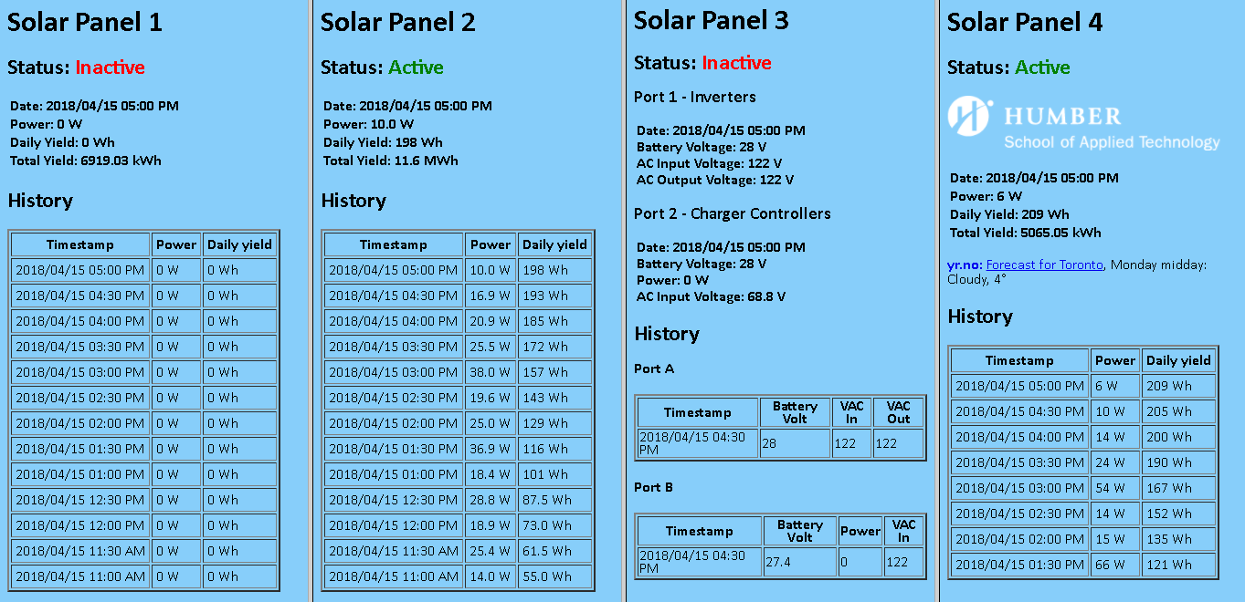
HTML

Slide 15
Conclusions/Recommendations
Our system can only be used for companies that wish to use solar energy as an alternative energy source
This is not a project for personal use unless it's on a smaller scale
We would not be able to mass produce it because it would be way out of our budget since the solar panels and equipment would cost thousands and we would need more than three people to be working on the entire system
We would recommend this project as a school project if the hardware is provided because it would cost thousands of dollars to create this project for your own personal use

